Slide 1
The RTL-SDR V3 SDR Receiver Dongle
A First Look
Jack K. Horner, W0JKH
Email: jhorner@cybermesa.com
Personal web site: http://jkhorner.com

Slide 2
Objective
To describe an integration and “quick look” test of
  RTL-SDR V3 Software Defined Radio (SDR) receiver dongle, with
  a PC, running
    Windows 10
    SDRsharp (SDR operation, display, and control software)
    WSJT-X (weak signal software)
    VB-Cable soft cable (to link SDRsharp with WSJT-X)

Slide 3
Overview
What is a software defined radio (SDR) receiver?
What is the RTL-SDR V3 dongle?
Test platform
Installation/integration entertainment
Proof-of-life testing
Many uses
Safety
Overall assessment
References

Slide 4
What is an SDR Receiver?
An SDR receiver (Laufer 2018; Youngblood 2002)
  Receives RF
  Digitizes the RF
  Demodulates the digitized RF
  Sends the demodulated signal to a computer (e.g., to a PC, typically via a USB port using a standardized USB-compatible display/audio format (e.g., MPEG-2))
  Processes the resulting signal on the computer
For a general introduction to digital signal processing (not limited to amateur radio), see tutorials.com 2023 and Holton 2021
(Excluding the cost of the computer) prices range from a few tens, to a few thousands, of dollars

Slide 5
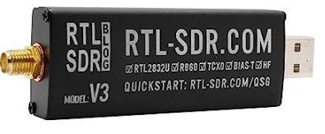
What is the RTL-SDR V3 dongle?(1)
[about 1” wide x 3” long x ½” thick]

Slide 6
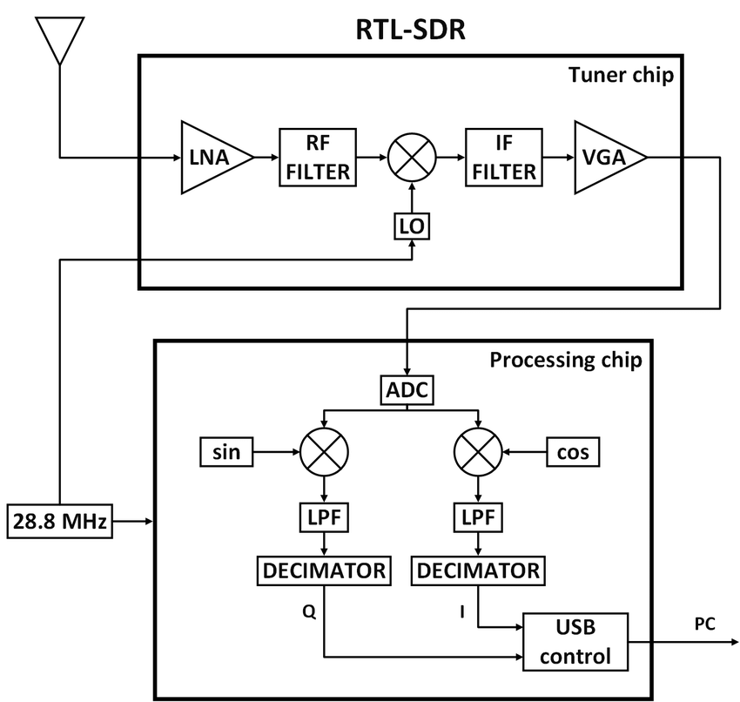
What is the RTL-SDR V3 dongle? (2)

Slide 7
What is the RTL-SDR V3 dongle? (3)
Some specs (from RTL-SDR.com 2023b)
  frequency range: 500 kHz - 2.4 GHz
  direct sampling of RF inputs below 28.8 MHz; conversion to IF, followed by sampling, for RF inputs above 28.8 MHz
  2.8 MHz max stable bandwidth
  8-bit ADC -- ~50 dBs of dynamic range
  < 4.5 dB noise figure LNA
  50-ohm RF in, MPEG-2 to PC USB port
  Current draw: nominally ~280 mA; peak is ~2 A

Slide 8
Test platform (1), hardware
  Dell Inspiron 545 (Intel® Core(TM) Quad CPU Q8200, 2.33 GHz, 4 cores)
    8 GB physical memory
    1 TB disk, 500 GB free
  RTL-SDR V3
  Various antennas, via 50-ohm coax
  Atolla™ USB hub

Slide 9
Test platform (2), software (on PC)
  Windows 10
  SDRSharp (SDR monitor/control software; airspy.com 2019)
  WSJT-X (weak-signal software; WSJT-X 2023)
  64-bit VB-Cable soft cable (to link SDRSharp with WSJT-X; VB-Audio 2015)

Slide 10
Installation/integration entertainment: hardware
Dongle
  Didn’t fit front panel USB ports (computer case occluded dongle case)
  Does fit some USB ports on rear panel, but …
  Generates significant heat, especially at high end of frequency range. Surface temp is approximate human body temp
My fix: installed dongle in a USB extension hub, leaving at least 1” of clearance on all sides

Slide 11
Installation/integration entertainment
Software with hardware:
Integration of RTL-SDR V3 with SDRSharp

Slide 12
Integration of dongle with SDRSharp (1)
Error message: “Can’t find audio out port”
  This error message is not documented in any of the items in the Reference section of this slide set
  Although not advertised as such, this is an installation showstopper
  I looked at my platform under Windows/System Configuration and couldn’t identify anything that was beyond doubt an “audio out port”
My fix: plugged a set of headphones into the computer’s audio out jack. Other fixes might be possible, but exploring them wasn’t my first priority

Slide 13
Integration of dongle with SDRSharp (2)
Error message: “Unexpected fatal error”
  This message is not documented in any of items in the Reference section of this slide set
  Error callback trace is captured by SDRSharp, but is useless unless you have the source code (it’s available, but it is poorly documented (for a definition of “poorly documented”, see Boehm et al. 2000))
  Message eliminates all but “billions and billions” (Sagan 1997) of possibilities (Symons and Horner 2014, 2020)

Slide 14
Integration of dongle with SDRSharp (3)
“Unexpected fatal error” message, cont’d
Conflicting hints
  Some, but not all, RTL-SDR installation documentation says that RTL-SDR requires V7.3 .NET (Microsoft) resources (files)
  Documentation says that V7.3 .NET resources “very likely” are already installed (they weren’t on my Windows 10 installation, which is automatically updated once per week)
My fix: installed V7.3 .NET resources (Microsoft provides an installation script)

Slide 15
Installation/integration entertainment
Integration of RTL-SDR V3 with SDRSharp and WSJT-X

Slide 16
VB-Cable soft cable integration of SDRSharp and WSJT-X
VB-Cable installation quirks (some tolerance of conceptual dissonance required)
  VB-Cable installation-instruction screen layouts differ from SDRSharp screen layout defaults
  Some of the default parameter values shown in the VB-Cable installation documentation conflict with those enforced by SDRSharp
  Some VB-Cable and SDRSharp names for the same entities differ
  Installation software allows choice of 32-, vs. 64-bit (memory-model) drivers. User must ensure that the memory models of the versions of Windows, SDRSharp, WSJT-X, and VB-Cable in play cohere.

Slide 17
Proof-of-life testing (1)
I did not explicitly perform clock synchronization or frequency calibration prior to testing
It would be wise to do both: digital communication modes are time-sensitive on various scales
Instructions for performing clock synchronization and frequency calibration that are adequate [for the uses mentioned in these slides] can be found at links in RTL-SDR.com 2023a)

Slide 18
Proof of life testing (2)
Attached dongle antenna port (via 50-ohm coax), in turn, to
  a half-wave dipole resonant at ~100 MHz located inside a room made of poured reinforced concrete (rebar/mesh acts somewhat like a Faraday cage); checked commercial broadcast FM bands. Copied ~5.
  an exterior VHF/UHF J-pole (50-ohm impedance, ~10 m above ground); checked for traffic on several local 2-m repeaters – found traffic on two
  an exterior EFHW multiband antenna (MFJ-1984MP, 50-ohm impedance; ~10 m above ground, oriented approx. N-S); monitored 20 m for a few minutes. Copied ~10 CW, and ~10 USB, stations

Slide 19
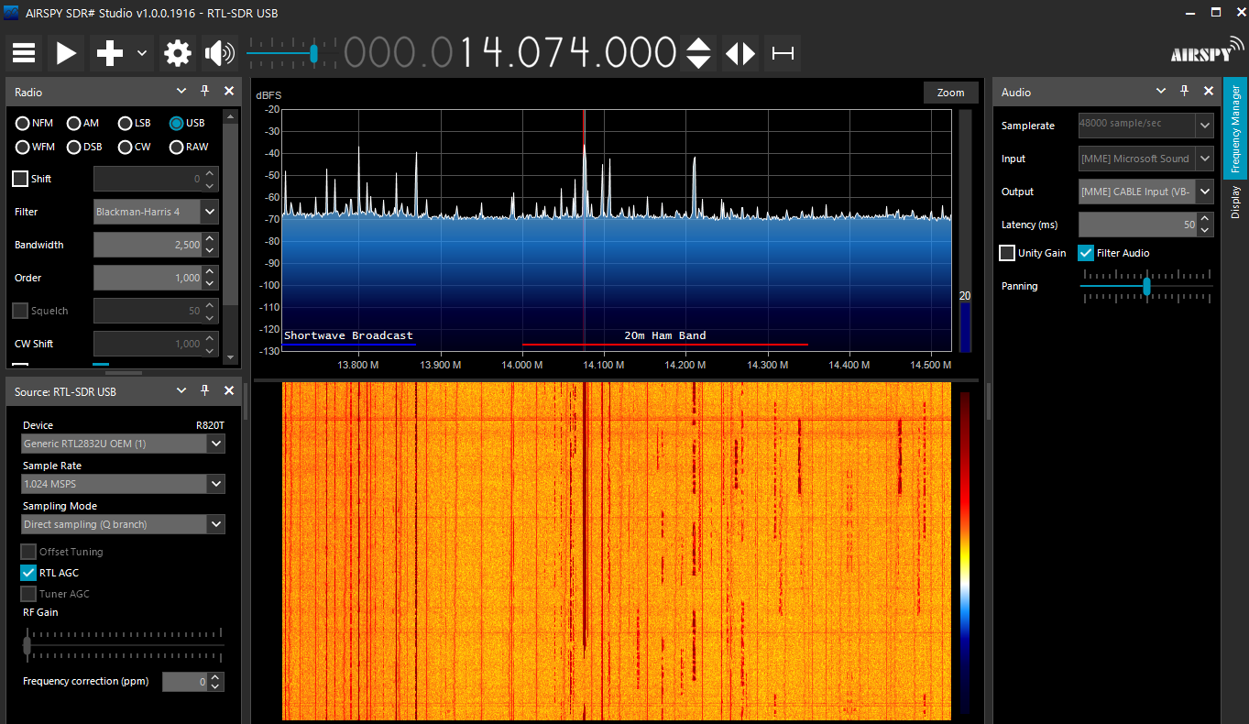
Proof-of-life testing (3) [soft-cable configuration of SDRSharp (and dongle) for WSJT-X FT8 monitoring on 20 m]

Slide 20
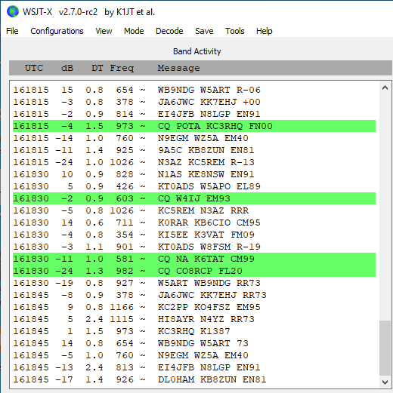
Proof-of-life testing (4) [WSJT-X FT8 monitoring of SDRSharp output, 20 m, 15 August 2023]

Slide 21
Proof-of-life testing (5)
RTL-SDR Users Guide is good; more troubleshooting information would be welcome
SDRSharp user interface is highly similar to that of SDRuno (often used with SDRplay™ SDRs). I was
  Already familiar with SDRuno
  Able to navigate most of SDRSharp without reading the manual

Slide 22
Many uses (1)
Tracking aircraft positions with ADSB decoding
Decoding unencrypted digital voice transmissions such as P25/DMR/D-STAR
Tracking maritime boat positions like a radar with AIS decoding
Tracking and receiving meteorological agency launched weather balloon data
Listening to amateur radio
Decoding ham radio APRS packets

Slide 23
Many uses (2)
Receiving GPS signals and decoding them
Using RTL-SDR as a spectrum analyzer
Receiving NOAA weather satellite images
Radio astronomy
Monitoring meteor scatter
Use RTL-SDR as a noise figure indicator
Decoding Inmarsat STD-C EGC geosynchronous satellites
Listening to the ISS (International Space Station)

Slide 24
Many uses (3)
For additional uses, see
  Laufer 2018
  RTL-SDR 2023a
Legalities: in many countries, it is illegal to relay, to third parties, some of the information that can be received/processed by this device and associated application software. Penalties include large fines and jail time.

Slide 25
Safety
If used in a combined transmit/receive (T/R) regime, SDR receiver configuration described above will require a T/R switch suitable for SDR use (e.g., MFJ-1708BSDR; MFJ 2023)
As always, grounds should be implemented in accordance with best practices (see Silver 2017 for details)

Slide 26
My overall assessment
Installation was
  not “plug-and-play”
  a character-building experience (but not as much “fun” as the Star Trek Kobayashi Maru challenge (Wikipedia 2023))
Although the configuration described above does not have all the capabilities of multi-thousand-dollar SDRs, it
  has impressive performance for the price
  is adequate for typical amateur use

Slide 27
For copy of these slides, see
  http://jkhorner.com/AMATEUR_RADIO/RTL_SDR_V3_SDR_Dongle.pptx

Slide 28
References (1)
airspy.com. (2019). SDRSharp for RTL-SDR/Windows 10-compatible version. https://airspy.com/download/.
Boehm B et al. (2000). Software Cost Estimation with COCOMO II. Prentice Hall.
Holton T. (2021). Digital Signal Processing: Principles and Applications. Cambridge.
Laufer C. (2018). The Hobbyist’s Guide to the RTL-SDR.
MFJ Enterprises. (2023). MFJ-1708B-SDR. https://mfjenterprises.com/collections/all/products/mfj-1708b-sdr .
RTL-SDR.com. (2023a). https://www.rtl-sdr.com/.

Slide 29
References (2)
RTL-SDR.com. (2023b). RTL-SDR Blog V3 Datasheet. https://www.rtl-sdr.com/wp-content/uploads/2018/02/RTL-SDR-Blog-V3-Datasheet.pdf .
RTL-SDR.com. (2023c). SDRSharp download. https://www.rtl-sdr.com/rtl-sdr-quick-start-guide/sdrsharpdownload/.
Sagan C. (1997). Billions and Billions: Thoughts on Life and Death at the Brink of the Millennium. Random House.
Silver HW. (2017). Grounding and Bonding for the Radio Amateur. ARRL.
Symons JF and Horner JK. (2014). Software intensive science. Philosophy and Technology 27, pp. 461-477. Accessible at https://www.johnsymons.net/wp-content/uploads/2017/04/Software-Intensive-Science-2014.pdf.

Slide 30
References (3)
Symons JF and Horner JK. (2020). Why there is no general solution to the problem of software verification. Foundations of Science 25, pp. 541–557. A draft is accessible at https://kuscholarworks.ku.edu/bitstream/handle/1808/29420/Symons_Horner_2019_SoftwareVerification.pdf?sequence=1.
WSJT-X (2023). WSJT-X Home Page. https://wsjt.sourceforge.io/wsjtx.html
Tutorialspoint.com. (2023). Digital Signal Processing Tutorial. https://www.tutorialspoint.com/digital_signal_processing/dsp_signals_definition.htm
VB-Audio. (2015). VBCABLE_Driver_Pack43.zip
(1.09 MB - OCT 2015 / XP to WIN11 32/64 bits). https://vb-audio.com/Cable/ .

Slide 31
References (4)
Wikipedia. (2023). Kobayashi Maru. Accessible at https://en.wikipedia.org/wiki/Kobayashi_Maru.
Youngblood G. (July/August 2002). A software defined radio for the masses. QEX, pp. 13-21. Accessible at https://arrl.org/files/file/Technology/tis/info/pdf/020708qex013.pdf.

